Slide 1
Parallel Processing
Md. Yasir Arafat
Lecturer
Dept. of computer science & Engineering
Jessore university of science & technology

Slide 2
Overview
What is Parallel Computing
Why Use Parallel Computing
Concepts and Terminology
Parallel Computer Memory Architectures
Parallel Programming Models
Examples
Conclusion

Slide 3
Parallel Processing/Computing
a mode of operation in which a process is split into parts, which are executed simultaneously on different processors attached to the same computer.
In computers, parallel processing is the processing of program instructions by dividing them among multiple processors with the objective of running a program in less time.
Parallel processing is a method of simultaneously breaking up and running program tasks on multiple microprocessors, thereby reducing processing time. Parallel processing may be accomplished via a computer with two or more processors or via a computer network.
Parallel processing is also called parallel computing.

Slide 4
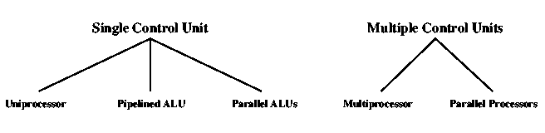
Computer Organizations

Slide 5
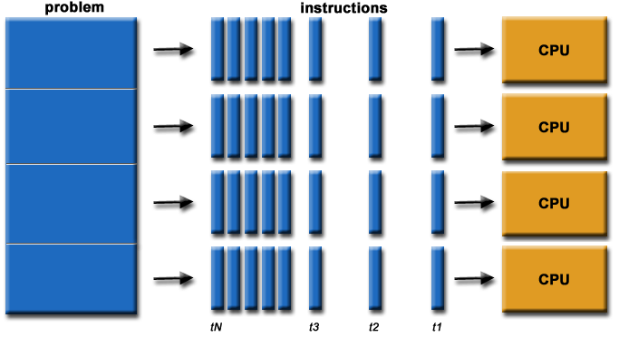
Parallel Processing Simulation

Slide 6
Why Use Parallel Computing?
Saves time
Solve larger problems
Cost savings
Provide concurrency

Slide 7
Parallelism Types
Data Parallelism
Task Parallelism

Slide 8
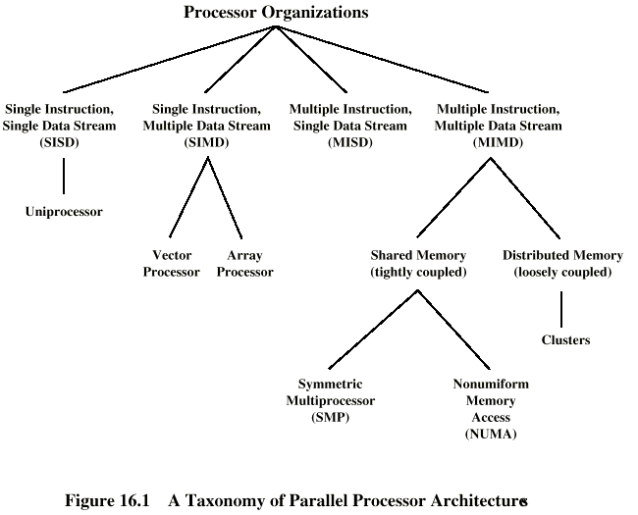
Taxonomy of Parallel Processor Architectures

Slide 9
Concepts and Terminology: Flynn’s Classical Taxonomy
Distinguishes multi-processor architecture by instruction and data
SISD – Single Instruction, Single Data
SIMD – Single Instruction, Multiple Data
MISD – Multiple Instruction, Single Data
MIMD – Multiple Instruction, Multiple Data

Slide 10
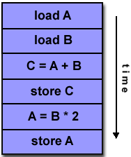
Flynn’s Classical Taxonomy: SISD
Serial
Only one instruction and data stream is acted on during any one clock cycle

Slide 11
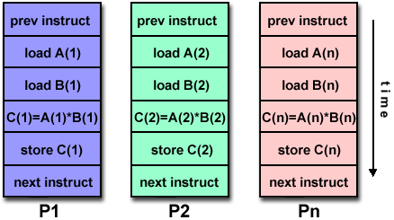
Flynn’s Classical Taxonomy: SIMD
All processing units execute the same instruction at any given clock cycle.
Each processing unit operates on a different data element.

Slide 12
Flynn’s Classical Taxonomy: MISD
Different instructions operated on a single data element.
Example: Multiple cryptography algorithms attempting to crack a single coded message.

Slide 13
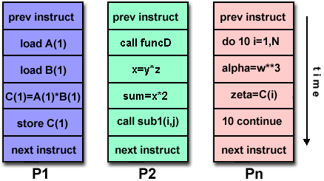
Flynn’s Classical Taxonomy: MIMD
Can execute different instructions on different data elements.
Most common type of parallel computer.

Slide 14
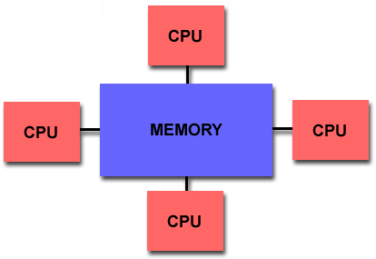
Parallel Computer Memory Architectures: Shared Memory Architecture
All processors access all memory as a single global address space.
Data sharing is fast.
Lack of scalability between memory and CPUs

Slide 15
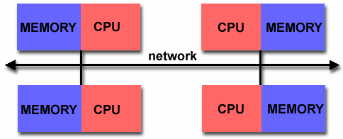
Parallel Computer Memory Architectures: Distributed Memory
Each processor has its own memory.
Is scalable, no overhead for cache coherency.
Programmer is responsible for many details of communication between processors.

Slide 16
Parallel Programming Models
Shared Memory Model
Messaging Passing Model
Data Parallel Model

Slide 17
Parallel Programming Models: Shared Memory Model
In the shared-memory programming model, tasks share a common address space, which they read and write asynchronously.
Locks may be used to control shared memory access.
Program development can be simplified since there is no need to explicitly specify communication between tasks.

Slide 18
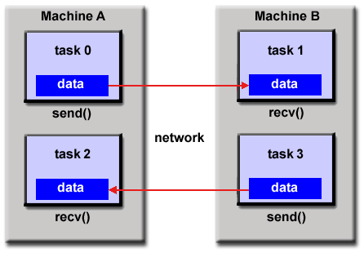
Parallel Programming Models: Message Passing Model

Slide 19
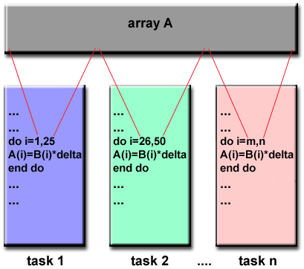
Parallel Programming Models: Data Parallel Model

Slide 20
Parallel Programming Models: Shared Memory Model
In the shared-memory programming model, tasks share a common address space, which they read and write asynchronously.
Locks may be used to control shared memory access.
Program development can be simplified since there is no need to explicitly specify communication between tasks.

Slide 21
Parallel Programming Models: Message Passing Model

Slide 22
Parallel Programming Models: Data Parallel Model

Slide 23
Designing Parallel Programs
Partitioning -
Domain Decomposition
Functional Decomposition
Communication
Synchronization

Slide 24
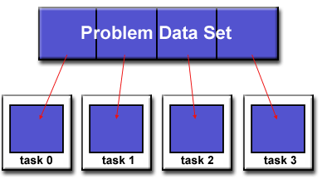
Partition : Domain Decomposition
Each task handles a portion of the data set.

Slide 25
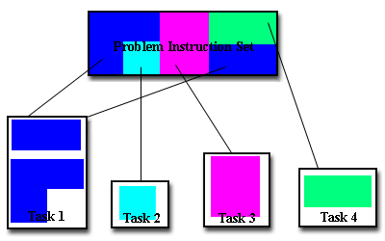
Partition Functional Decomposition
Each task performs a function of the overall work

Slide 26
Designing Parallel Programs Communication
Synchronous communications are often referred to as blocking communications since other work must wait until the communications have completed.
Asynchronous communications allow tasks to transfer data independently from one another.

Slide 27
Designing Parallel Programs Synchronization
Types of Synchronization:
Barrier
Lock / semaphore
Synchronous communication operations

Slide 28
Example:
As a simple example, if we are running code on a 2-processor system (CPUs "a" & "b") in a parallel environment and we wish to do tasks "A" and "B" , it is possible to tell CPU "a" to do task "A" and CPU "b" to do task 'B" simultaneously, thereby reducing the runtime of the execution.

Slide 29
Example: Array Processing
Serial Solution
Perform a function on a 2D array.
Single processor iterates through each element in the array
Possible Parallel Solution
Assign each processor a partition of the array.
Each process iterates through its own partition.

Slide 30
Conclusion
Parallel computing is fast.
There are many different approaches and models of parallel computing.

Slide 31
References
https://computing.llnl.gov/tutorials/parallel_comp
Introduction to Parallel Computing, www.llnl.gov/computing/tutorials/parallel_comp/#Whatis
www.cs.berkeley.edu/~yelick/cs267-sp04/lectures/01/lect01-intro
http://www-users.cs.umn.edu/~karypis/parbook/

Slide 32
Thank You

